Slide 1

Supporting the Support Vector Machines
(SVMs)

Slide 2
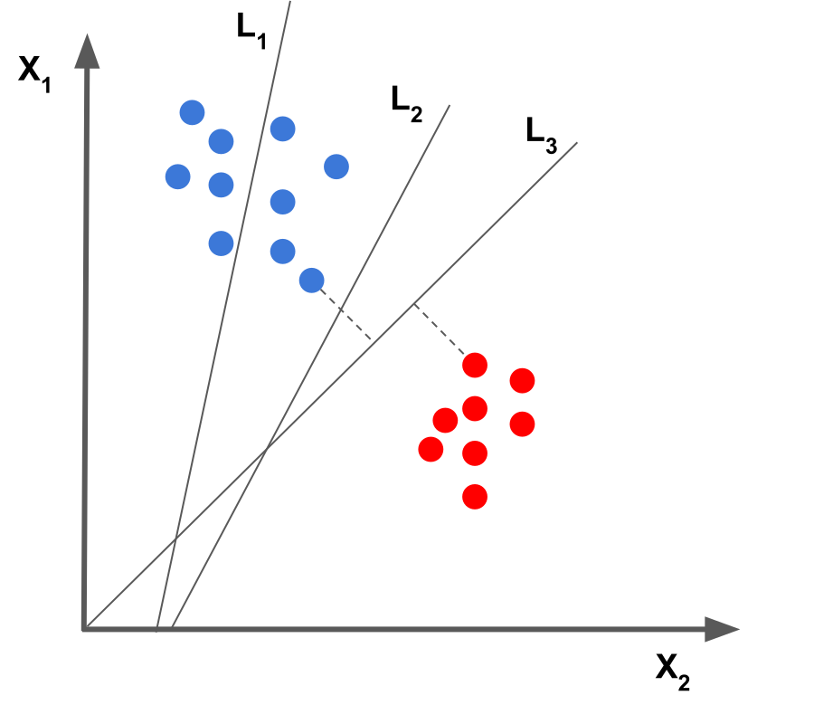
Which Decision Boundary best fits the given data?
Hint: Try to think in terms of patterns and corner points!
Note: Never forget about extending concepts in n-dimensions

Slide 3
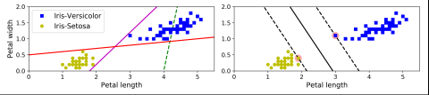
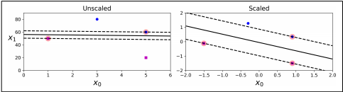
Decision boundary of left plot is not good as compared to right plot.
Data when not scaled can have adverse effects like one feature not having much importance
Addition of data which is on either side of the street won’t affect the model.
Best with datasets of small-medium range. ~10k because time complexity can go over cubic for certain kernels.

Slide 4
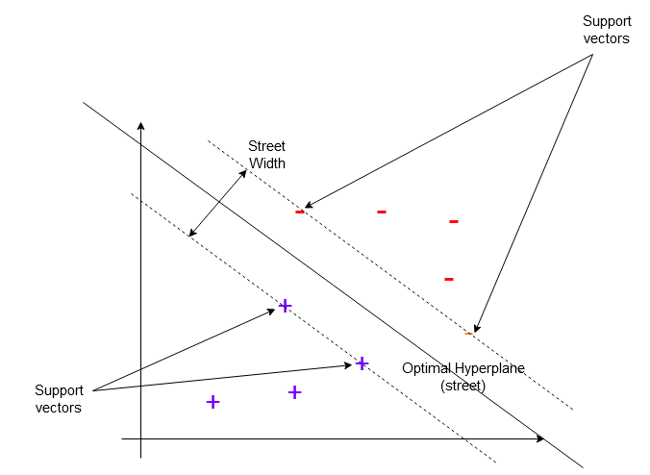
Jargon Alerts !
Street
Street Width
Support Vectors
Hyperplane

Slide 5
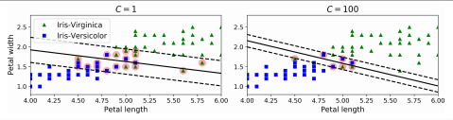
Soft Margin and Hard Margin Classification
In hard margin classification the instances are strictly on their side of their street.
In soft margin classification some street violations are allowed.
The amount of violations that are tolerated depend on the hyperparameter c.
c is the inverse of the tolerance.
The lower it is the wider the street is and the better it genralizes.

Slide 6
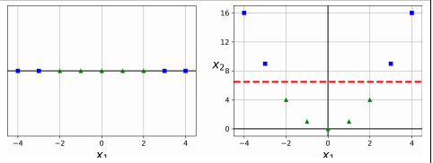
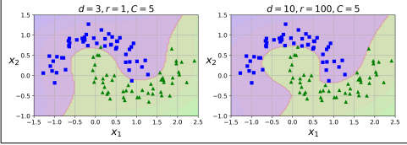
Non linear data
Not all data is linear and thus linearly separable.
Converting linear data to high dimension data gives it more features and thus makes it more separable.
Higher the degree will be the closer will be the fit. It’s a hyperparameter that can be tuned.

Slide 7
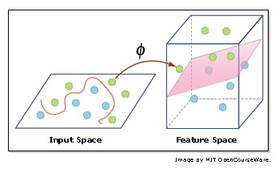

Kernel Trick
Separates non-linear data
Doesn’t actually convert data vectors in higher dimensions, just assumes!
The above computation for dot product using kernel

Slide 8

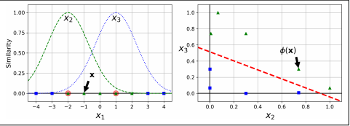
Gaussian Kernel
Sigma represents similarity between x and y
Similarity
Sigma
General-purpose Kernel
Function is given by

Slide 9
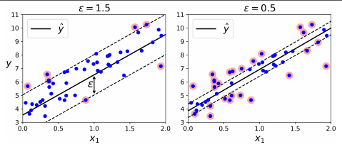
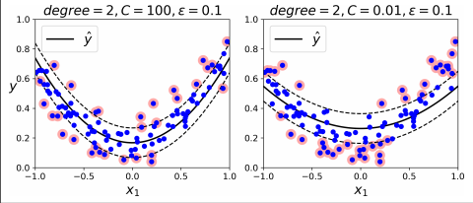
Support Vector Regression
Similar to SVC’s but the main intuition is to increase the width of the street instead of reducing it to accommodate the maximum number of instances.
The decision boundary is actually the line of best fit.
Unlike other models that try to minimize the error between the real and predicted value, SVR tries to fit the best line within a threshold value.
The threshold value is the distance between the hyperplane and boundary line.
Like SVC’s non linear data is also considered.
Eta is a hyperparameter which decides the width of the street.

Slide 10
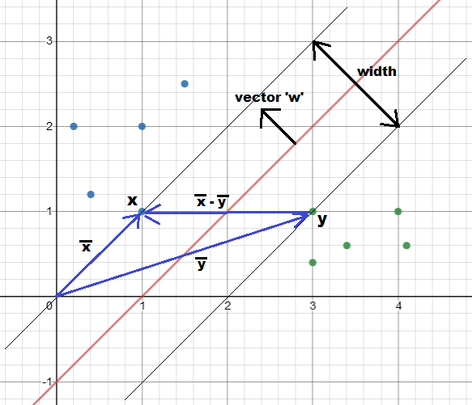
Maths behind SVMs
We try to is maximize the width of the street to find optimum hyperplane
Variables:
w - perpendicular vector to decision boundary
x,y - support vectors of two classes
b - the decision boundary constant.

Slide 11




Easy way to calculate street width
Step 1: Defining Width
Step 3: Separate equations for classes
Step 2: General Support Vector Equation
Step 4: Final Width Expression

Slide 12
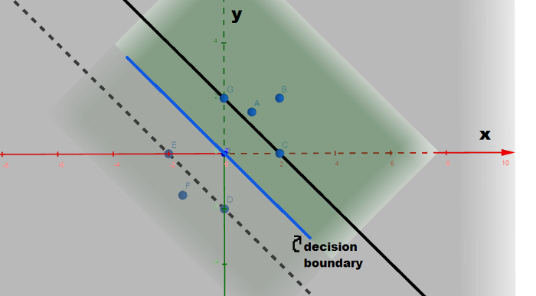
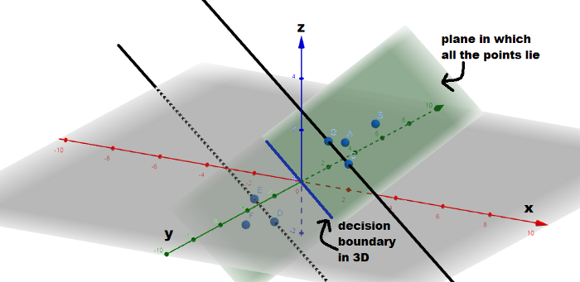
Introducing 3D for better visualization !
The third coordinate ‘z’ is given by
z = w.x + b

Slide 13
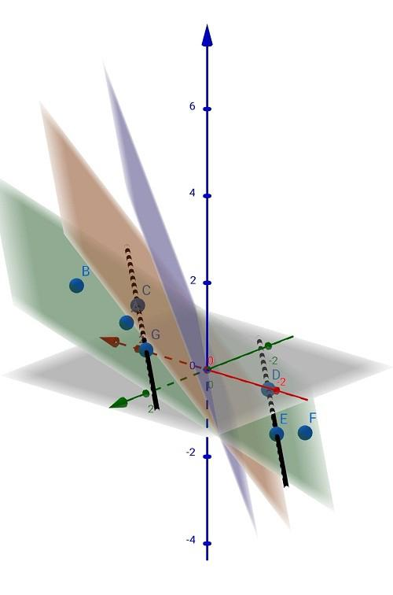

Why ‘1’ only in w.x+b=1?
Since we have selected ‘1’, plane has slope
If we wish to change 1 to any other number, we can but the plane will also rotate along decision boundary

Slide 14






Steps to find Street Width (Method 2)
Step 1
Step 4
Step 2
Step 5
Step 3
Step 6

Slide 15




Minimizing Street Width
(Using Lagrange’s Multipliers)
Step 1: Lagrange’s Multiplier by Definition
Step 3: Equation for ‘w’
Step 4: Differentiating wrt ‘b’
Step 2: Differentiating wrt ‘w’
Step 5: Result of partial differentiation

Slide 16


Minimizing Street Width
(Using Lagrange’s Multipliers)
Step 6: Substituting the values obtained
Step 7: Final expression

Slide 17
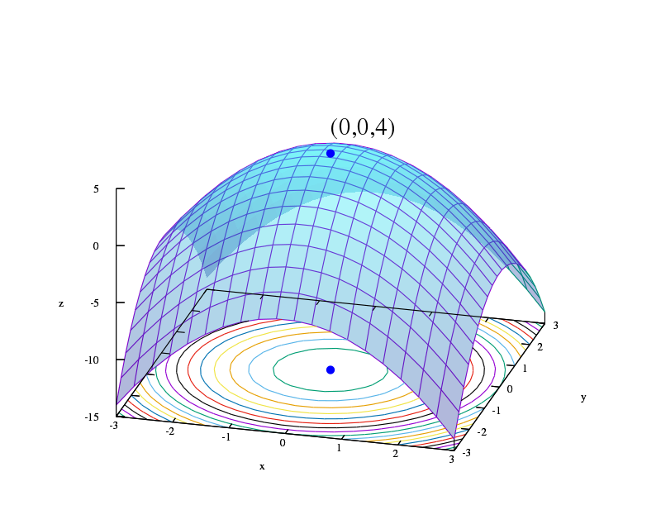
Computation of SVMs Equation
The Equation obtained can be further solved using Quadratic Programming
For more reference: https://en.wikipedia.org/wiki/Quadratic_programming
Why QP?
Hint: The equation for L is quadratic wrt to x and the constraints on x is linear.
Isn’t it a perfect recipe?

Slide 18
Rock it SVMs !
SVM is usually regarded as an efficient Machine Learning algorithms as it tries to find the best hyperplane
Obviously the above is not true always ! It’s ML, you can’t always be accurate
SVMs can always take n-features meaning the algorithm also works in n-dimension but we can’t demonstrate more than 3 dimensions due to human limitations
The kernel functions can also be used in other Machine Learning Algorithms
You are now beginning to understand SVMs! Thanks

